Slide 1
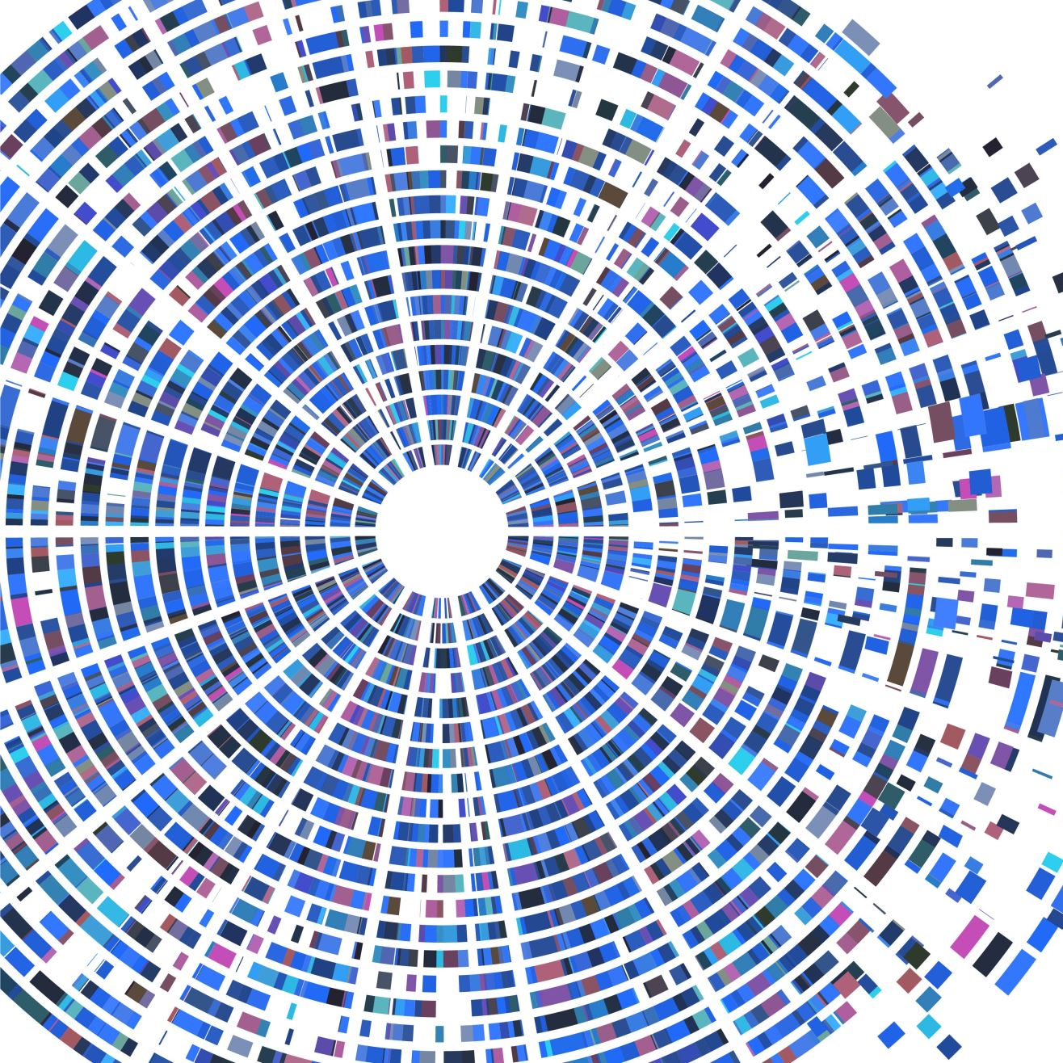
Digital Media Intelligence
Author:
Truc Huynh
Shrivathsa Gopala Krishna Kumar
Rahul Niranjan Srinivas

Slide 2
Purpose & Motivation
Get the overall visualization of YouTube video in multiple country
Analyzing trending videos to predict the trending
Provides market forecast and intelligence for professional video-maker on YouTube

Slide 3
Challenges to Tidy YouTube’s Trending dataset
Format data to readable format
Decide what data is necessary (i.e., only the month is selected from the variable trending_date...)
Decide what value is factors
Decide which value is the outliners and how to treat them (in this case we eliminate them)

Slide 4
Group Challenges
Communication: Due to COVID19, three team member are in 3 different states (Indiana, District of Columbus, and Boston)
Model : Choose which model is used to show the correlation between the trending month and publish month (Shrivathsa , and Rahul)

Slide 5
Original Dataset Description
The dataset includes several months of most trending YouTube videos in nine country.
The data is captured in the USA, Great Britain, Germany, Canada, France, Russia, South Korea, Mexico, and India.
Each country is recorded in a separate CSV file.

Slide 6
Original Data-types V.S. Tidy Data-types
 | Column name | Original Data type
1 | Video_id | String
2 | Trending_date | Date
3 | Title | String
4 | Channel_title | String
5 | Category_id | Integer
6 | Publish_time | Date
7 | Tags | String
8 | Views | Integer
9 | Dislikes | Integer
10 | Likes | Integer
11 | Comment_count | Integer
12 | Thumbnail_link | String
13 | Comments_disabled | Boolean
14 | Ratings_disable | Boolean
15 | Video_error_or_removed | Boolean
16 | Description | String
 | Column name | Tidy Data type
1 | Trending_month | Factor
2 | Title | String
3 | Channel_title | String
4 | Category_id | Integer
5 | Publish_month | Factor
6 | Tags | String
7 | Views | Integer
8 | Dislikes | Integer
9 | Likes | Integer
10 | Comment_count | Integer
11 | Thumbnail_link | String
12 | Comments_disabled | Boolean
13 | Ratings_disable | Boolean
14 | Video_error_or_removed | Boolean
15 | Description | String
16 | Days_of_week | Factor

Slide 7
Exploratory data analysis
Performing initial investigations on the obtained data to:
Build hypotheses
Expose anomalies present
Check assumptions
Result
Correlation map for the variables that present in the data
Initial graphical visualizations
Density Plot
Scatter Plot
After Analysis
Methods

Slide 8
Study of distribution of variables in the dataset
Density plot:
Scatter plot:
Using Density plot to check if all the continuous variables follow the normal distribution.
Thus, we can verify correlation whether it is valid or spurious.
Using Scatter Plots to check if all the selected variable pairs are not spurious

Slide 9
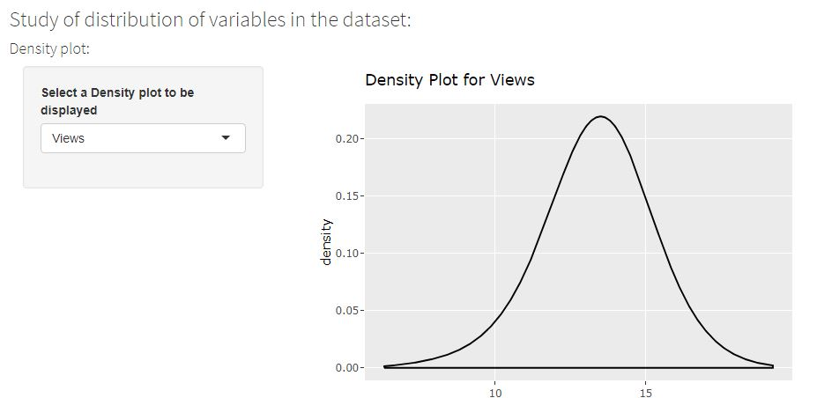
Density plot
Options in menu:
Views
Likes
Dislikes
Comment Count
Goal: Eliminate Spurious Correlations

Slide 10
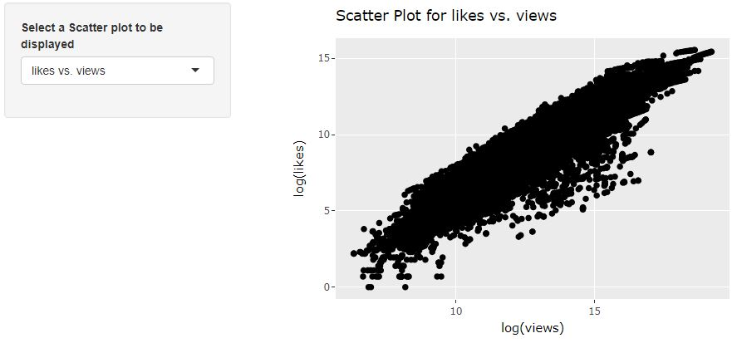
Scatter plot
Options in menu:
Likes vs. Views
Comment Count vs Likes
Comment Count vs Dislikes
Views vs. Comment Count
Publish Month vs. Trending Months
Goal: Confirm relationship is valid.

Slide 11
Correlation Study
Definition: measuring the strength of association between two variables.
Reasons: Determine the strength of association between variables in the dataset
Types:
Pearson Product Moment Correlation
Spearman Rank Correlation
Kendall Rank Correlation

Slide 12
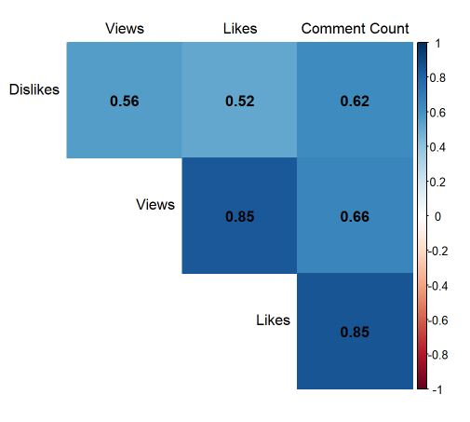
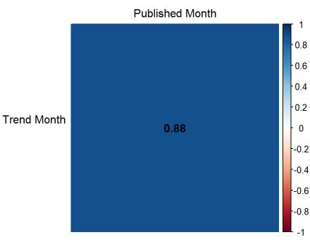
Applied Correlation Map
Pearson correlation graphical map
Spearman correlation map

Slide 13
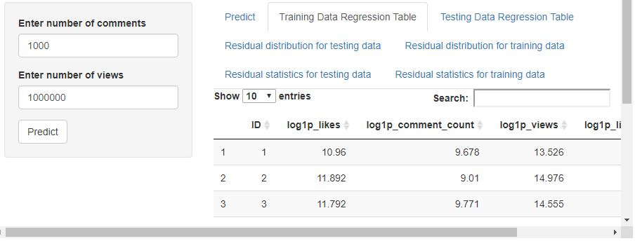
Predict the number of likes for a trending video
Each tab show different table
High R squared value explains that the prediction is accurate up to 81.4% of the time

Slide 14
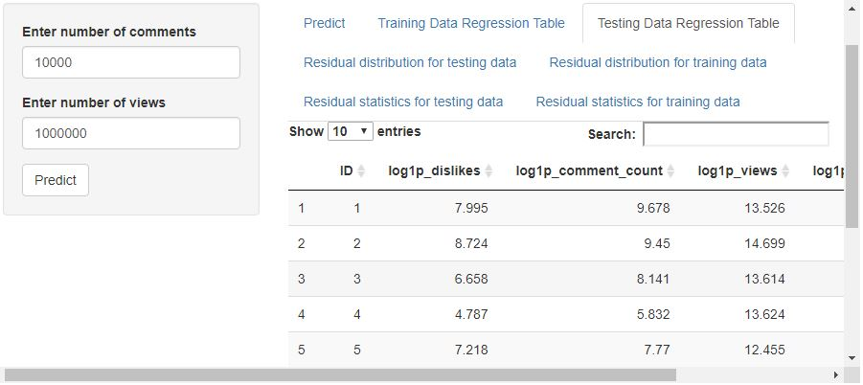
Predict the number of dislikes for a trending video
Each tab show different table
High R squared value explains that the prediction is accurate up to 78.8% of the time

Slide 15
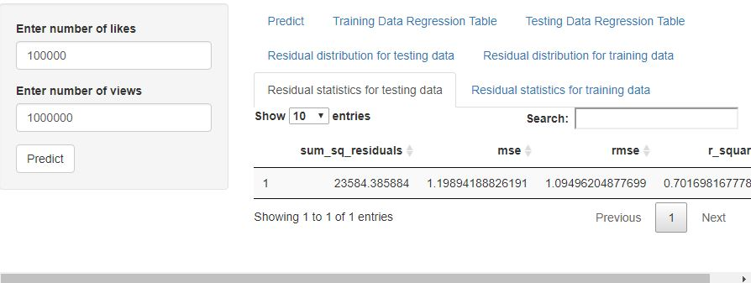
Predict the number of comments for a trending video
Each tab show different table
High R squared value explains that the prediction is accurate up to 70.9% of the time

Slide 16
Strategy - Conclusion
Use a density plot to explore the distribution of the response variables
Use correlation map to visualize
Use linear regression to predicts the number of likes, dislikes and comments
Use Shiny to make the hypothesis more interactive

Slide 17
References
AS (2017). JMP 13 Fitting Linear Models, Second Edition.
Clapham, M. E. (2016, Jan. 30) 19: Non-parametric correlation, Retrieved from https://www.youtube.com/watch?v=bAstMHbytK0.
Kerley, C. (2020, Mar. 25), What Are the Different Types of Correlations? Retrieved from https://sciencing.com/different-types-correlations-6979655.html.
McDonald, J.H. (2014), Handbook of Biological Statistics (3rd ed.). Retrieved from Sparky House Publishing, Baltimore, Maryland.
University of the West of England (n.d.), Data Analysis. Retrieved from http://learntech.uwe.ac.uk/da/Default.aspx?pageid=1442.

